Slide 1
Professional Training
Make the right decision:
Change from toxic cleaning products to natural green cleaning alternatives.

Slide 2

This training is partially funded by the University of Massachusetts – Lowell’s
Toxics Use Reduction Institute - TURI

Slide 3


Our Partners
ISPG/H
Immigrant Services Providers Group/Health

Slide 4
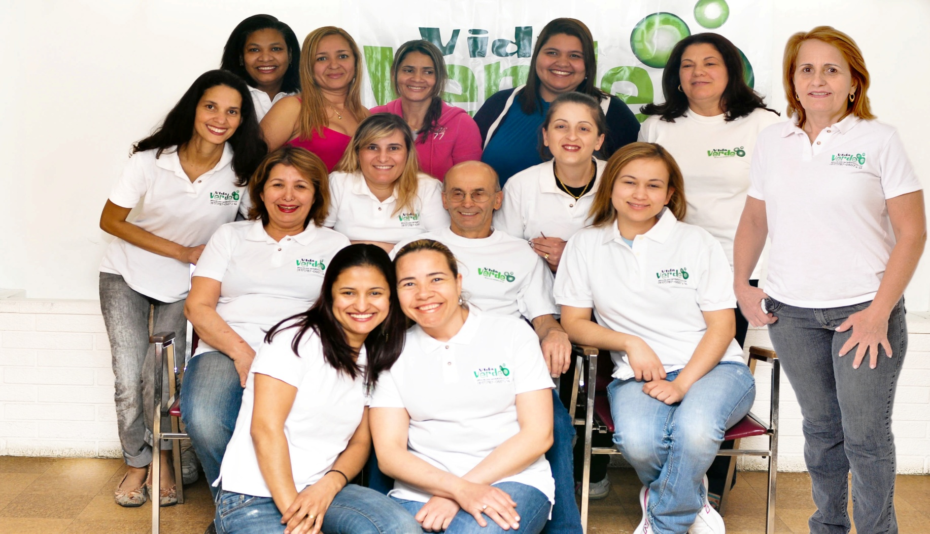
Who we are

Slide 5
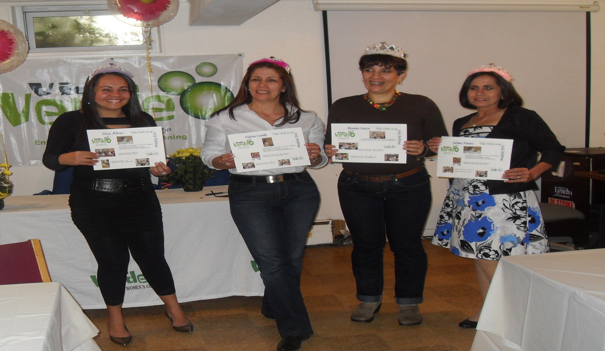
Vida Verde Cooperative New Members

Slide 6
Housecleaner Work related risks
- Chemicals
- Ergonomics
- Biologics
Organizational
We will focus on Chemical issues and safer alternatives today

Slide 7
Chemical Risks
The continuous exposure to toxics can make you sick and are not good to The Environment.

Slide 8
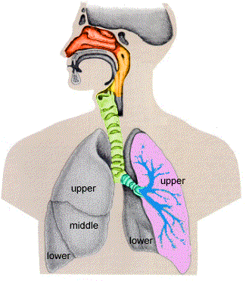
Health Problems related to Cleaning Products:
Asthma
Allergies
Skin Problems
Breathing Problems
Neurologic Problems
Conception Problems
Pregnancy problems

Slide 9
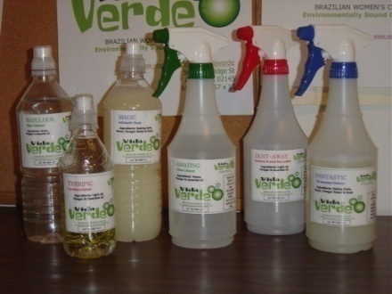
Vida Verde Natural Cleaning Products
Water
Vinegar
Baking Soda
Borax
Essential Oil
Grape seed Oil
Vegetal Soap

Slide 10
GREEN INGREDIENT | WHAT IT DOES
BAKING SODA | Cleans, deodorizes, mild abrasive, odor absorber
WHITE VINEGAR 5% acid (NEVER mix with Bleach) | Cuts grease, prevents mold and mildew, deodorizes, dissolves soap scum; kills 99 percent of bacteria, 82 percent of mold, and 80 percent of viruses
LIQUID SOAP (Vegetable Oil based, castile or glycerin- says no petroleum) | Removes dirt and grease
BORAX (20 Mule Team) A poison if ingested and should be kept away from children and pets at all times. | Cleans, deodorizes, disinfects, inhibits mold growth Naturally occurring alkaline mineral
OLIVE OIL | Shines
ESSENTIAL OIL (OR EXTRACT- less concentrated) Peppermint, lemon, lavender, etc. | Mostly used for deodorizing or scenting cleaners. Tea tree oil is a disinfectant.
10
DRAFT

Slide 11
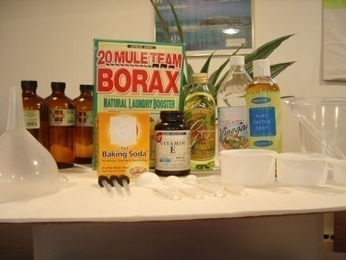
Recipes

Slide 12
Amazing
2 Cups (476 ml) → Water
1 Cup (238ml) → Vinegar
20 drops → Peppermint Essential Oil

Slide 13
FABULOUS
2 ½ Cup (357ml) → Water
½ Cup (357ml) → Vinegar
20 drops → Peppermint Essential Oil

Slide 14
MAGIC SOAP
2 ½ Cups (595 ml) → Water
3 Table Spoons (45ml) → Vegetal Soup
30 drops → Tea Tree Essential Oil

Slide 15
FANTASTIC
1/2 Tea Spoon (2,5ml) → Baking Soda
1 Tea Spoon (5ml) → Borax
2 Table Spoons (30ml) → Vinegar
1 Cup (240 ml) → Boiling Water
1 Cup (240 ml) → Cold Water
¼ Cup (60ml) → Vegetal Soup

Slide 16
DUST – AWAY
2 Cups (476 ml) → Water
1 Tea Spoon (5 ml) → Grapeseed Oil
¼ Cups (60ml) → Vinegar
20 drops → Peppermint or Lavender Essential Oil

Slide 17
TURI Lab Testing Results…
Add the results from the TURI lab testing!! It makes a compelling case that they do in fact work!!

Slide 18


If you are going to shop, shop for products that:
List all ingredients
Biodegradable
Are plant-based not petroleum-based
pH neutral (not a strong acid or base)
Packaged in pump-spray bottles not aerosol cans
Are third party certified
18
DRAFT

Slide 19
What to look for……..
Specific ecological labels like:
“no solvents” “plant-based”
“no phosphates “biodegradable in 3 to 5 days”
Not just “natural” or “eco-friendly” or “green”
(ex: Mean Green at Walmart’s is $1.24/qt but no ingredients are listed –
is it really “green” – what’s in it? - where’s the proof?)
Not just greenwashing….“no CFCs”
(CFCs have already been banned)
19
DRAFT

Slide 20
 | Pre-Made Cleaner Prices
All Purpose Cleaner | From Walmart: Lysol All Purpose disinfectant $2/qt (“quats”- occupational asthma, developmental toxin) Green Works $2.77/qt (DfE) Windex Surface Cleaner – Vinegar $2.97/qt Meyers All Purpose Cleaner $7.98/qt
Glass Cleaner | From Market Basket: ClearVue $2.79/qt (butylcellosolve – kidney and liver problems, etc) Green Works $2.99/qt Windex Original $3.68/qt (patented ingredients)
Oven Cleaner | From Market Basket: Easy Off $4.99/lb monoethanolamine (asthma); diethylene glycol n- butyl ether (developmental and reproductive toxin); “no CFCs “(Greenwashing- this is illegal anyway)
20
DRAFT
20

Slide 21
Furniture Polish | From Market Basket: Market Basket brand: $1.99/12.5 oz (aerosol) Pledge: $3.49/12.5 oz
Drain De-Clogger | From Market Basket: Mister Plumber $1.39/32 oz (corrosive – burns- strong base) Draino Liquid $ 2.79/32 oz (corrosive- burns- strong base)
Toilet Bowl Cleaner | From Market Basket: Market Basket brand: $1.79/24 oz (danger, strong acid, burns) The Works $1.59/32 oz (Danger, strong acid, burns)
21
DRAFT

Slide 22
COST COMPARISONS
 | Green Recipe | Pre-Made Cleaner
All Purpose Cleaner | $0.29 - $2.15 (per Qt) | $2 - $7.98 (per Qt)
Glass Cleaner | $0.29-$0.69 (per Qt) | $2.79-3.68 (per Qt)
Oven Cleaner | $0.27 (per pound) | $4.49 (per pound)
Furniture Polish | $0.43 (12.5 oz) | $1.99-3.49 (12.5 oz)
Drain De-Clogger | $0.75 (per Qt) | $1.39-2.79 (per Qt)
Toilet Bowl Cleaner | $0.67 (per Qt) | $1.39-2.79 (per Qt)
COST SAVINGS! | $2.70-$4.96 | $14.05-$25.22
22
DRAFT

Slide 23

GREEN INGREDIENTS
$2.12/4 lb Baking soda; Walmart in laundry isle
$ 2.98/4 lb Borax; Walmart
$ 2.32/gal White Vinegar; Walmart
$ 12.19/32 oz Dr. Bronner’s Castile Soap; Hannaford's
$19.61TOTAL
With these ingredients you’d have enough Castile soap to make
9 quarts of All Purpose Cleaner PLUS
enough vinegar and baking soda left over to make:
4 quarts of Toilet Bowl Cleaner
1 quart Glass Cleaner
clean the oven 2X (assuming you use 1 lb of baking soda each time)
$19.61
You save
$24.65!
(plus health care costs!)
If you bought the same amount of pre-made cleaners the cost would be:
9 Green Works All Purpose Cleaner at $2.77 each = $24.93
4 The Works Toilet Bowl Cleaner at $1.59 each = $ 6.36
1 Green Works Glass Cleaner at $2.99 each = $ 2.99
2 Easy Off oven cleaner at $4.99 each = $ 9.98
TOTAL = $44.26
DRAFT
23
23

Slide 24
For more information:
Vida Verde: http://verdeamarelo.org/vidaverde/
TURI: www.turi.org
TURI Cleaning Lab Do-It-Yourself Recipe Testing: http://www.turi.org/Our_Work/Green_Cleaning_Lab/Does_It_Clean/Do-it-Yourself_Recipes

